Slide 1
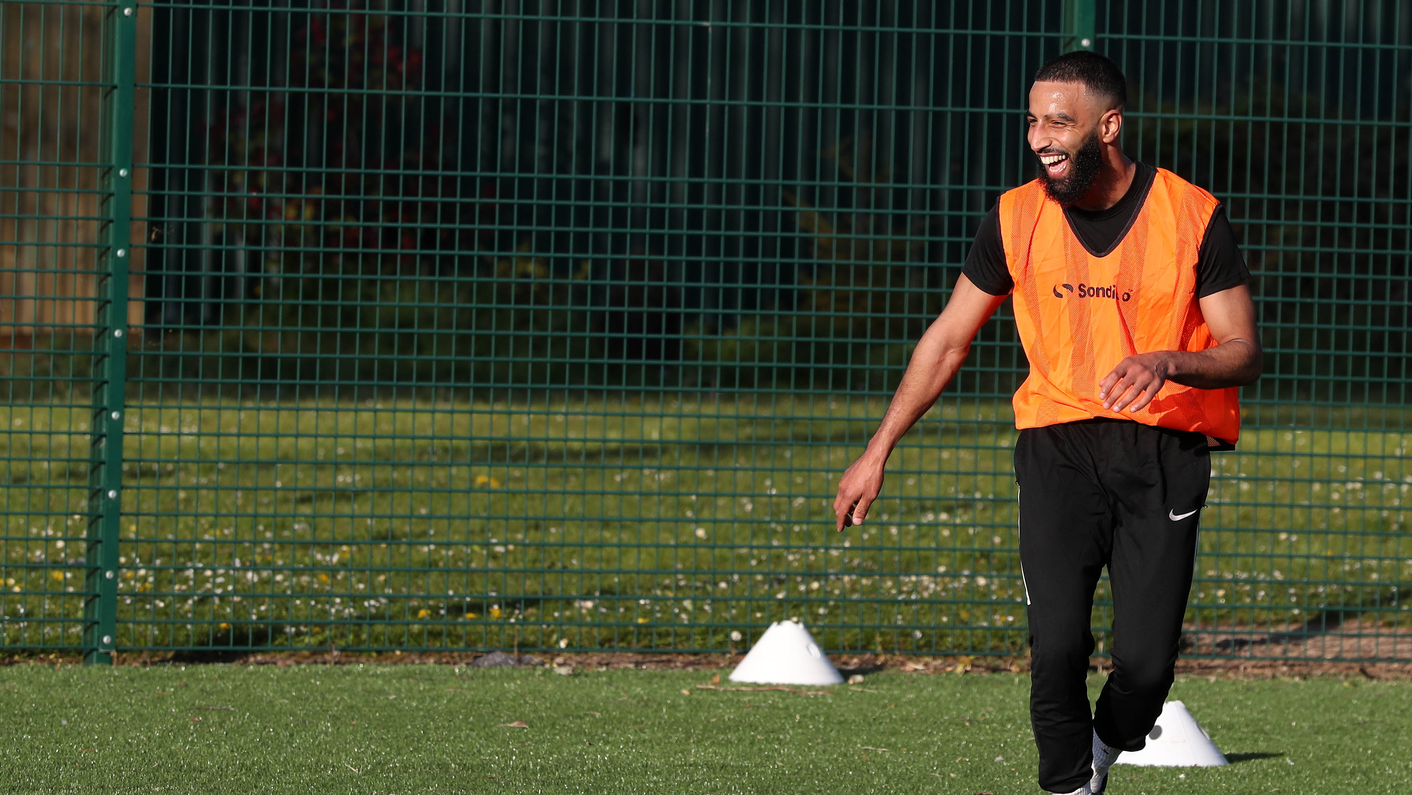

Slide 2
Key campaign messages
It’s time to get back in the game.
Getting active for just a little bit of time everyday can recapture that exhilarating feeling that only sport can give you.
Getting back in the game can help you not only reconnect with the sport you love but the community around it.
With restrictions easing and Spring well and truly underway, the options of how we can do this are starting to increase again.
It might have been a while since we’ve been able to play the sports we love but we’re in this together as we get our kit back on and rediscover our rhythm.
Getting active isn’t just good for your physical health, but the mental health impact from moving can last a long time.

Slide 3
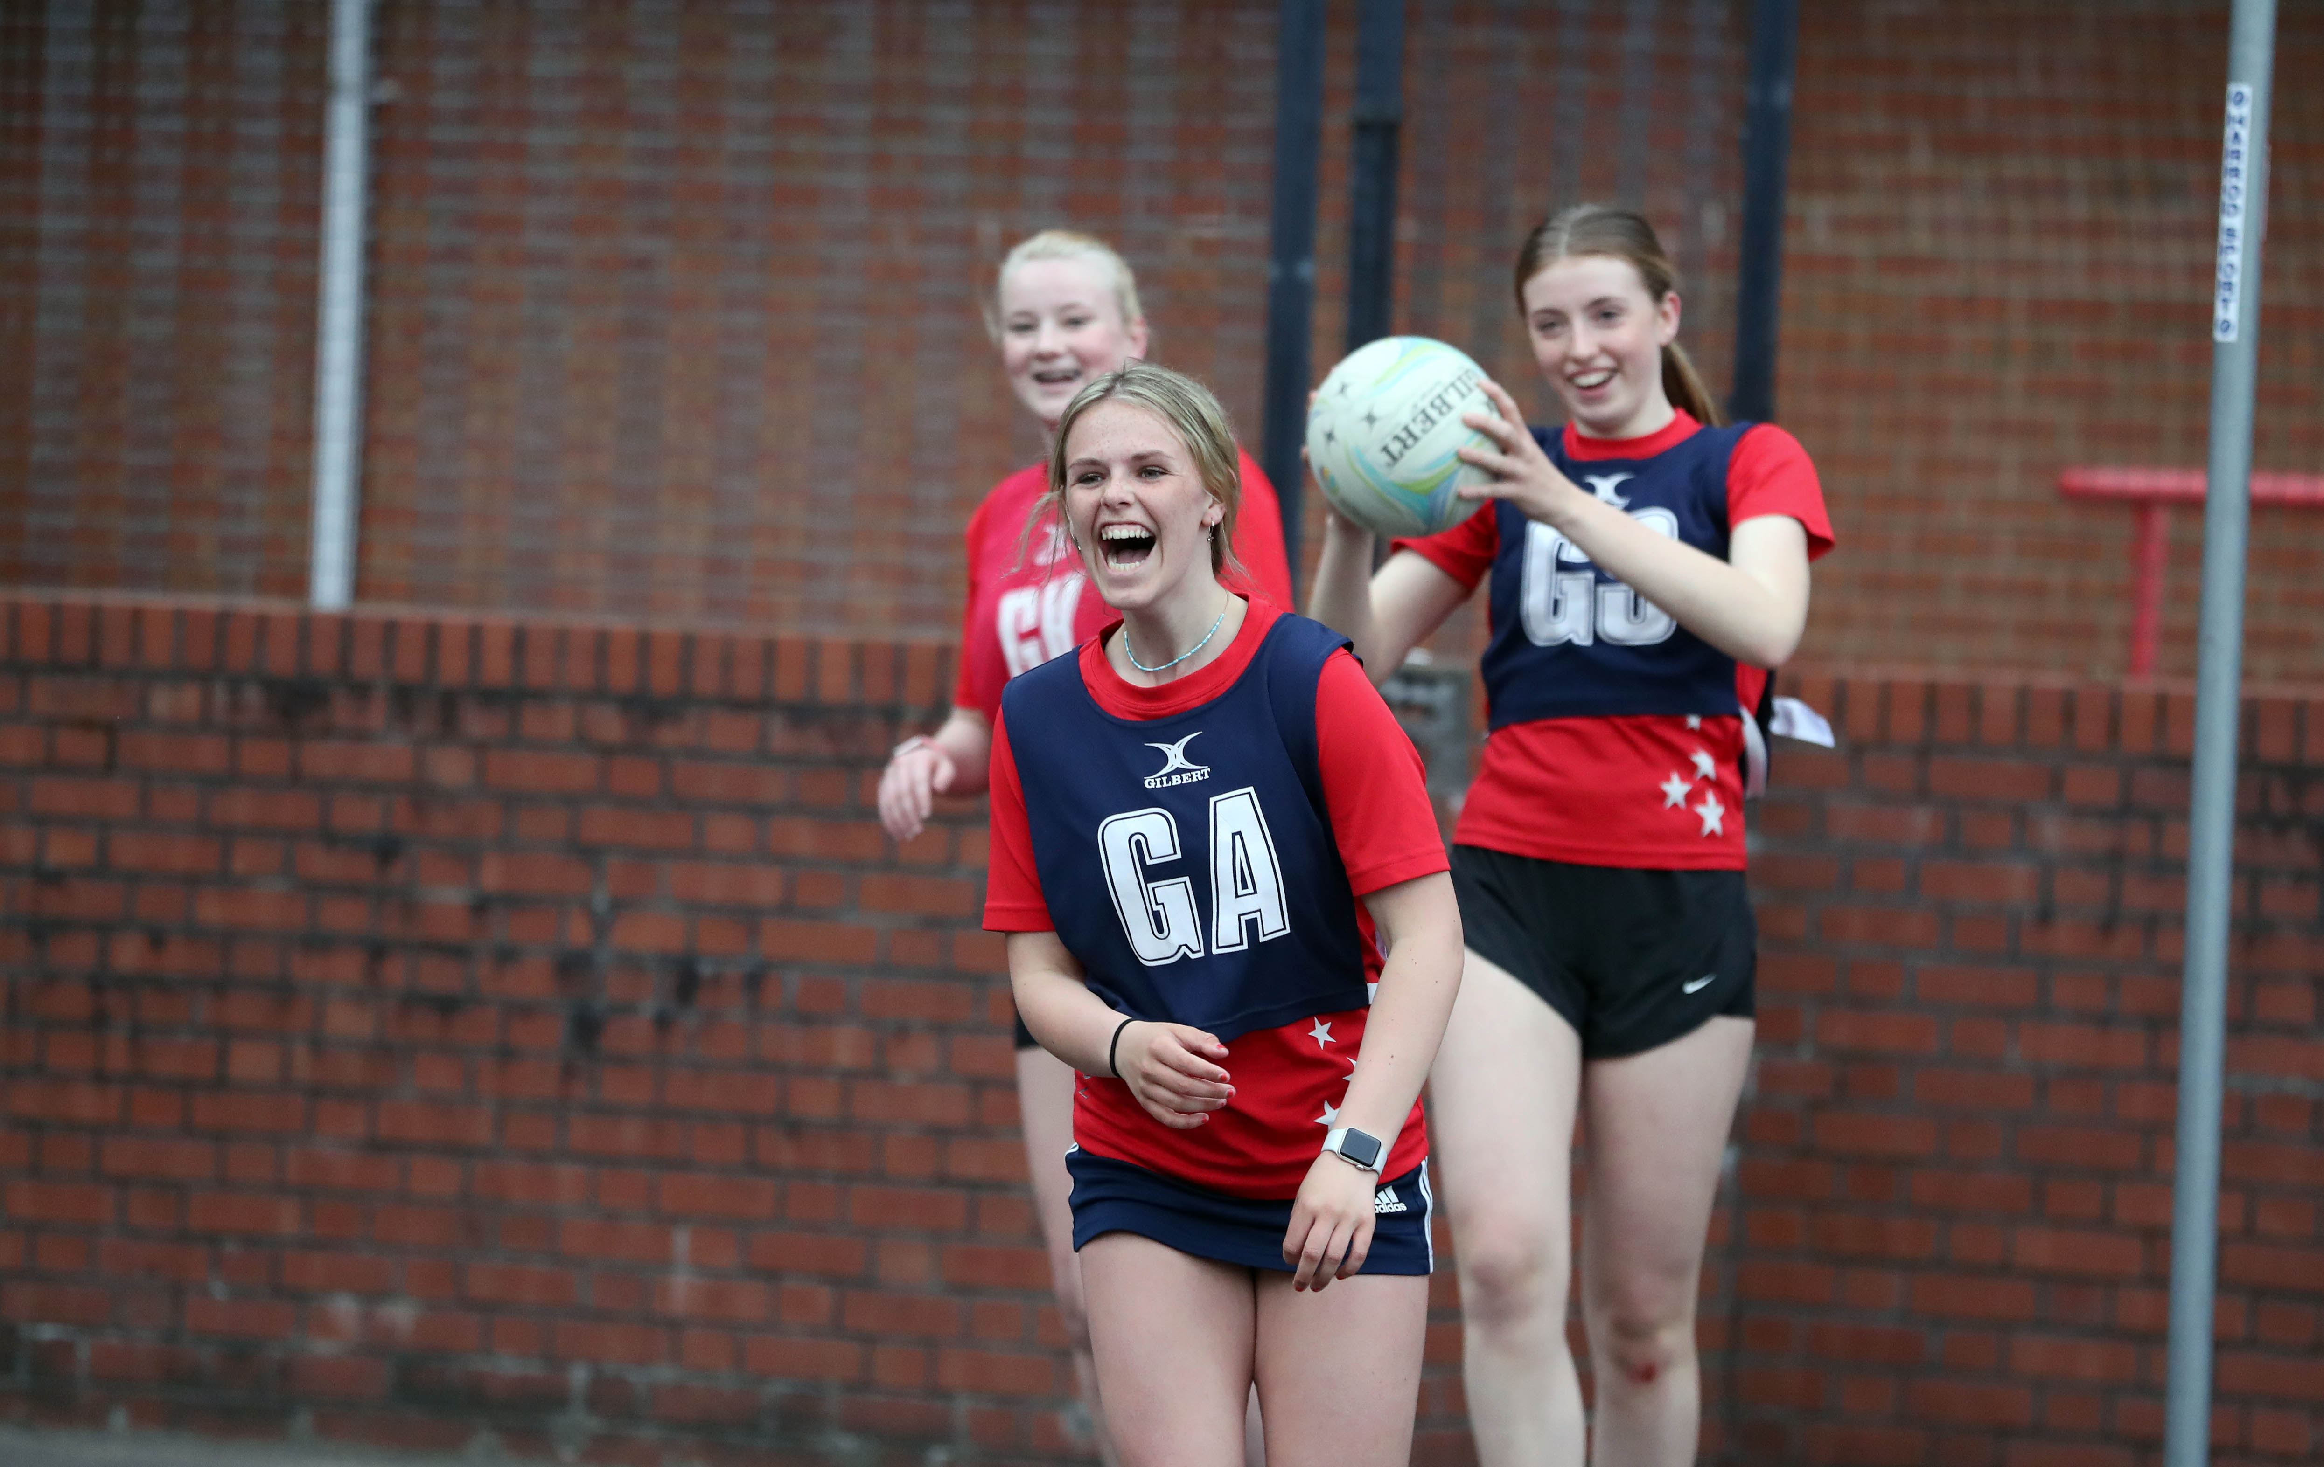
Social media
To help spread the word, here’s three ways you can support on social…
How: Posts about the opening of facilities and how people can return to sport.
Why: Posts encouraging people in your community to get back in the game and reconnect with the sport they love.
Who: Share positive and uplifting stories of your experiences getting back in the game.
Always use #BackinTheGame on posts

Slide 4
Social media suggested posts
Just copy and paste into your social channels (Twitter, Facebook and Instagram) and amend accordingly.
Here’s how we’re getting #BackintheGame at name of facility/team/club/organisation]💪
What have you missed most about [insert your sport]? #BackintheGame ❤️
With restrictions easing up, how are you getting #BackintheGame? Here at [name of facility/team/club/organisation], we’re [insert activity of choice].
Time to get your kit out and get #BackintheGame! Share your pics and stories with us.
It feels so good to be back! We've loved the feeling of getting seeing everyone in the community again and doing the sport we know and love ❤️ #BackintheGame

Slide 5
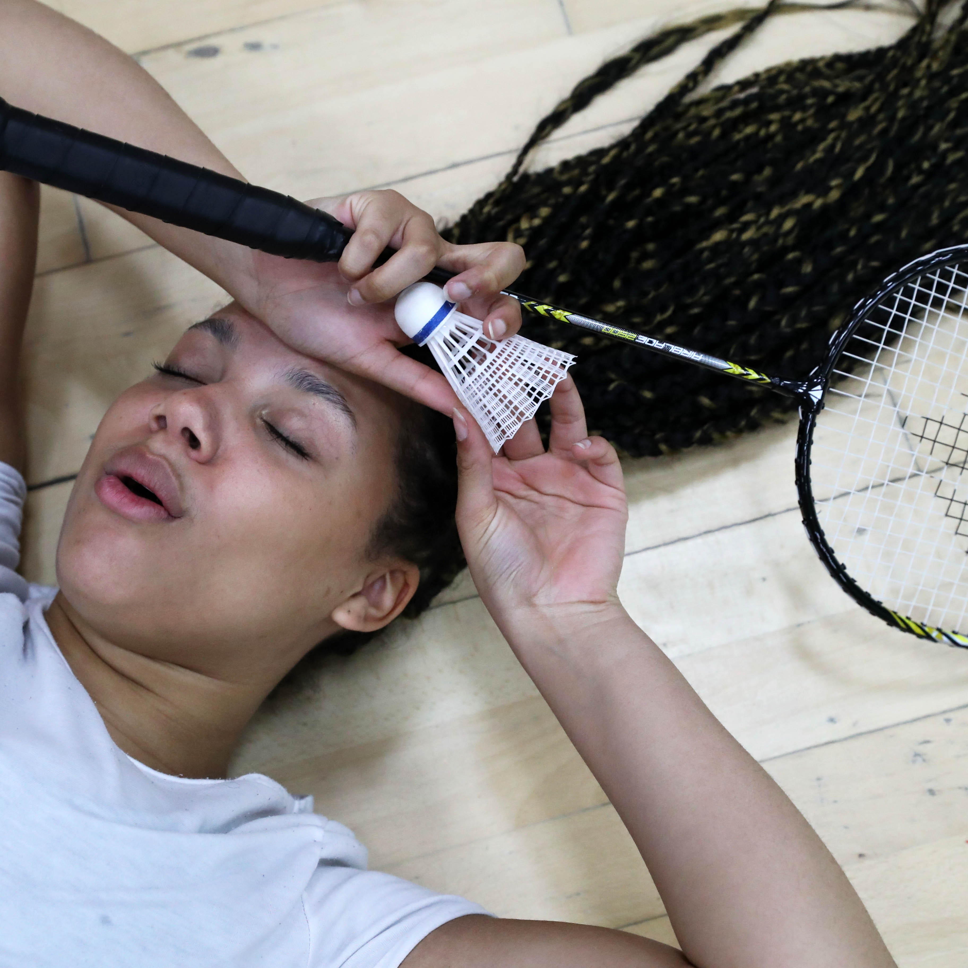
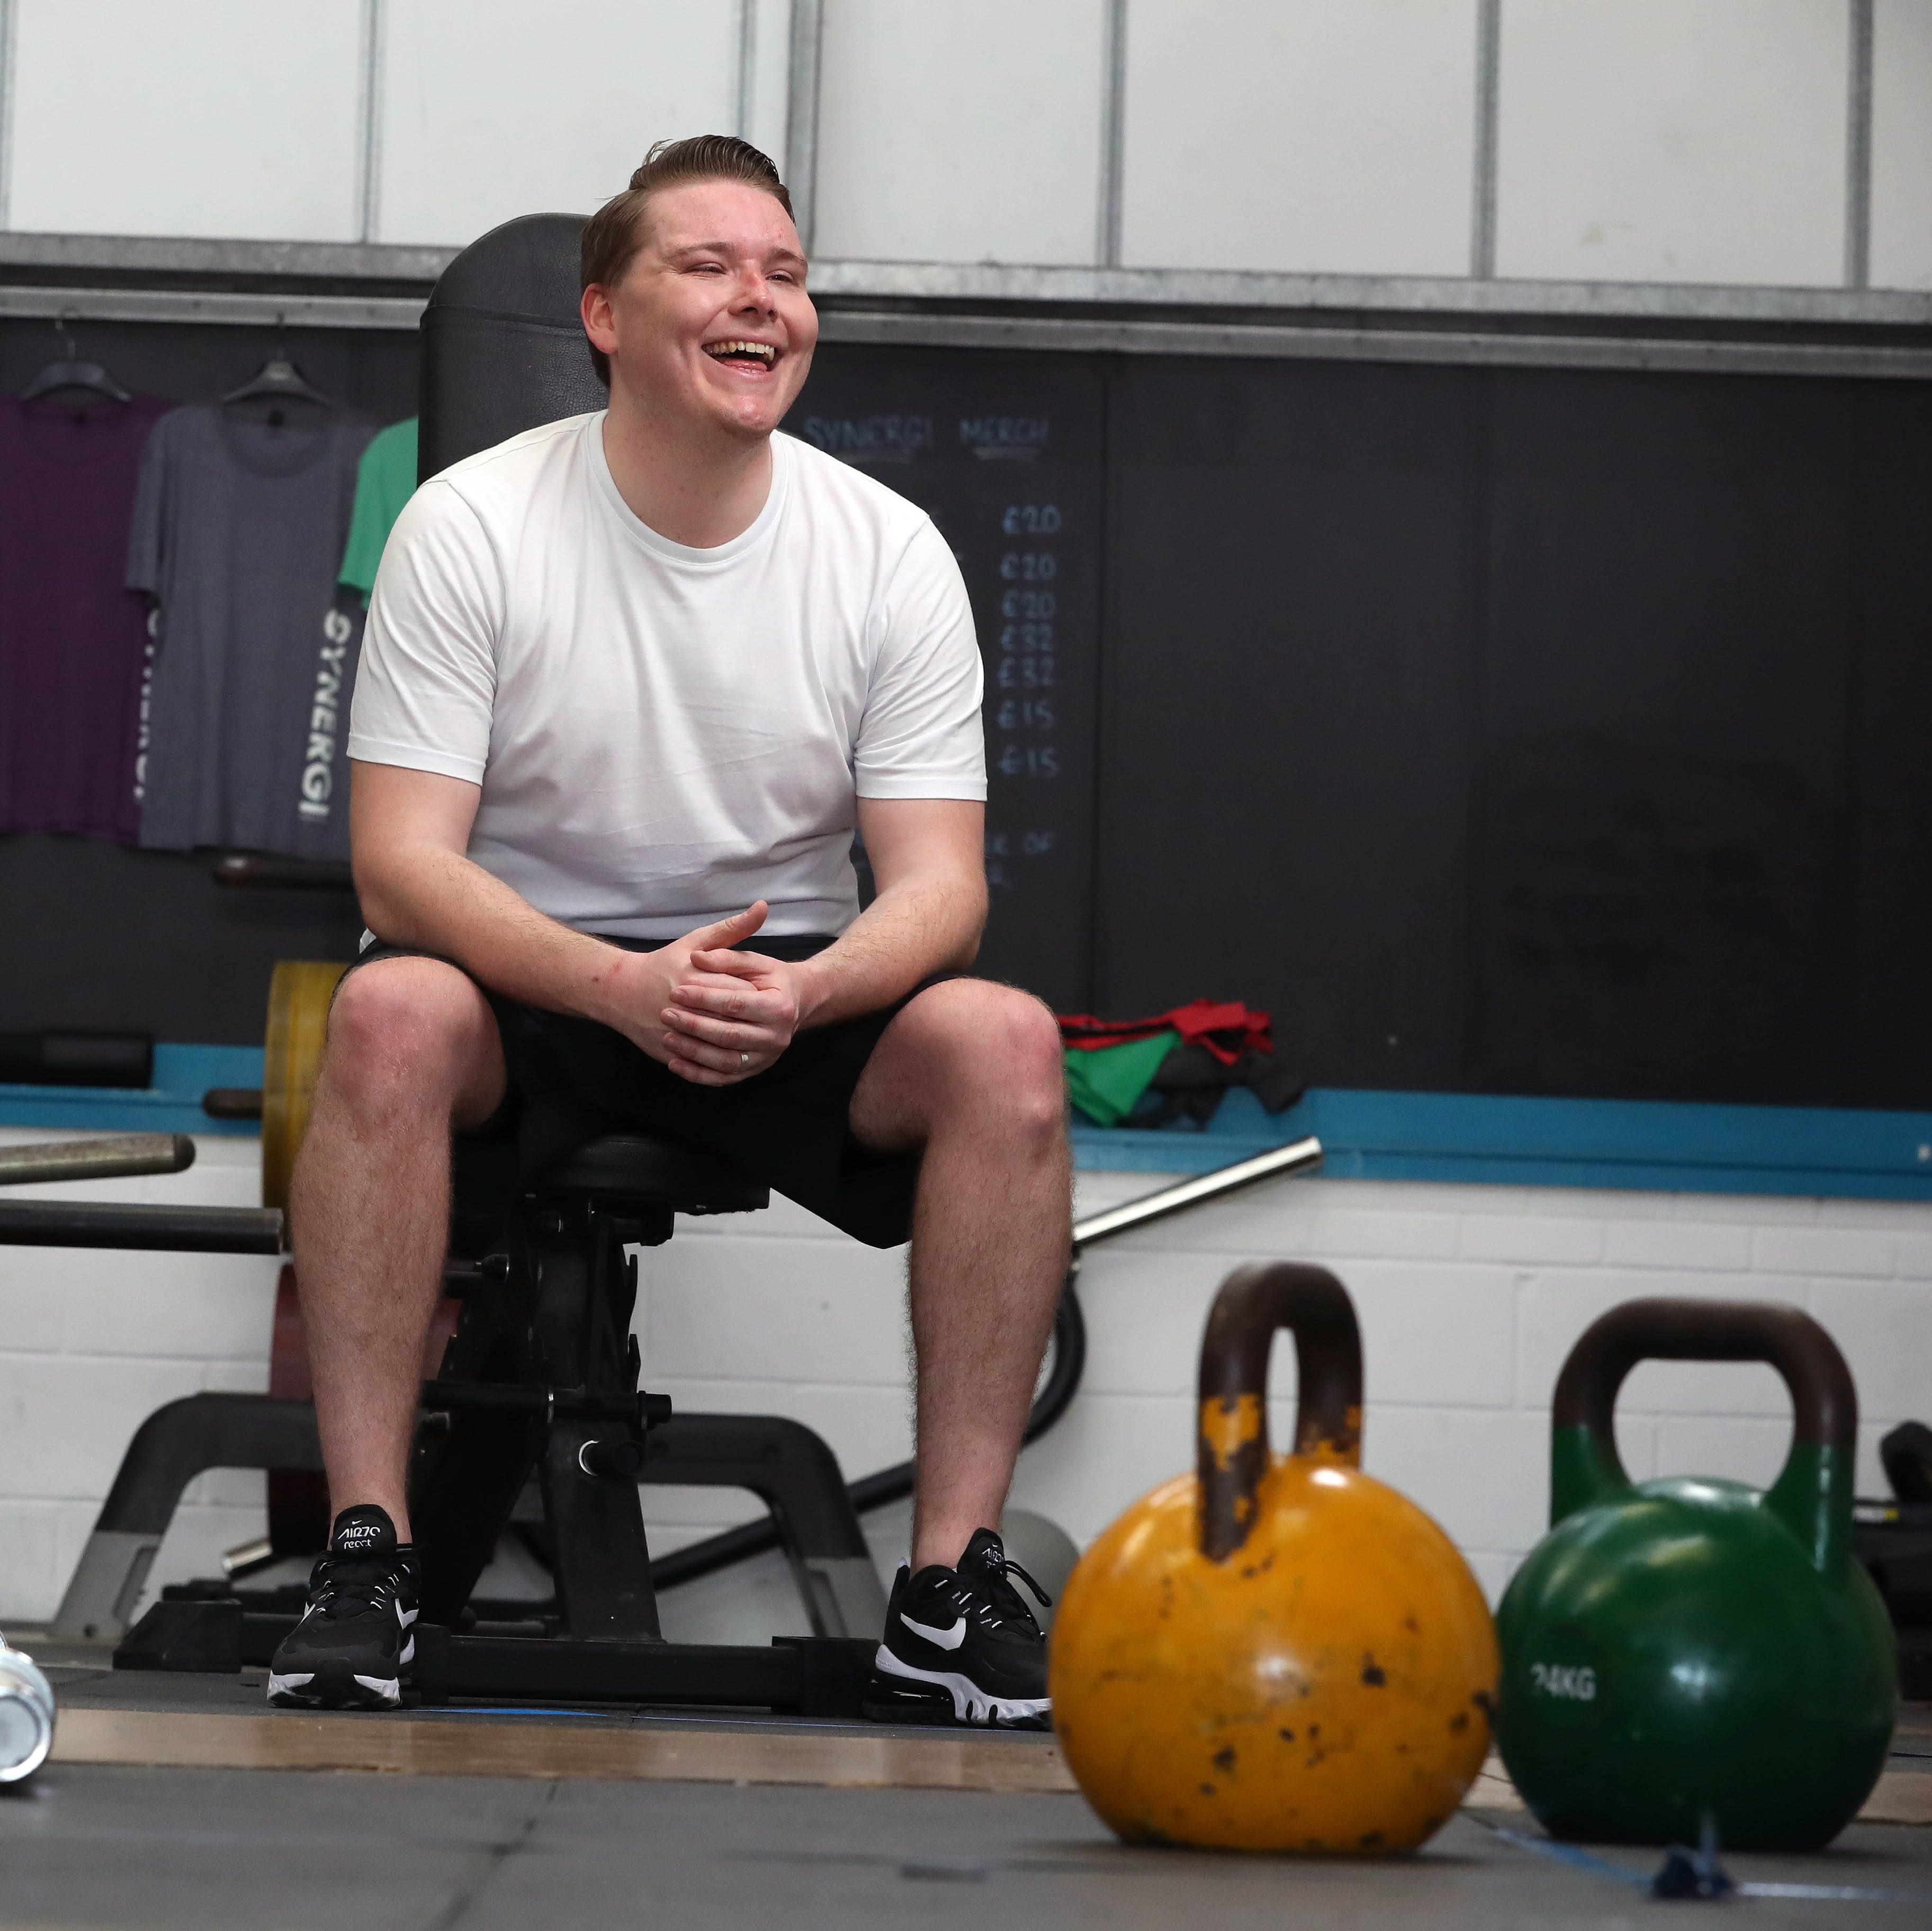
Social media:
Images of sport in action which to inspire your own #BackintheGame photos.

Slide 6
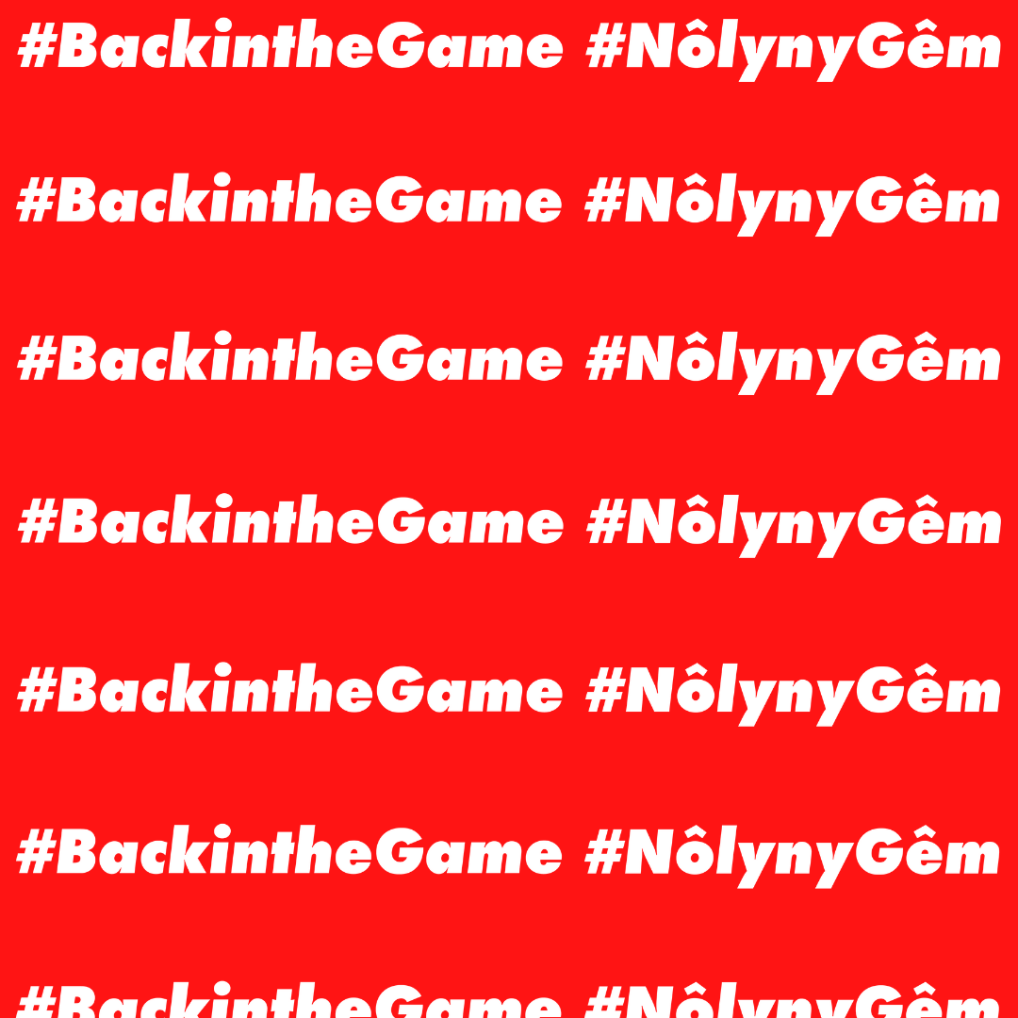
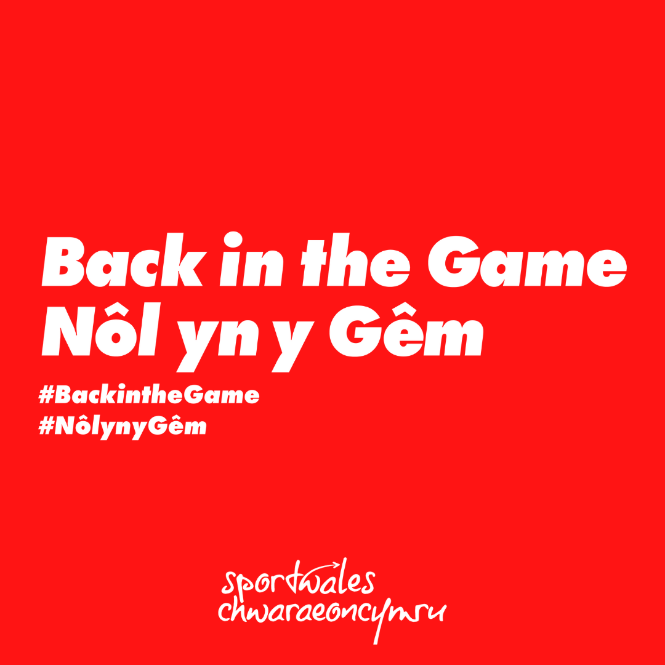
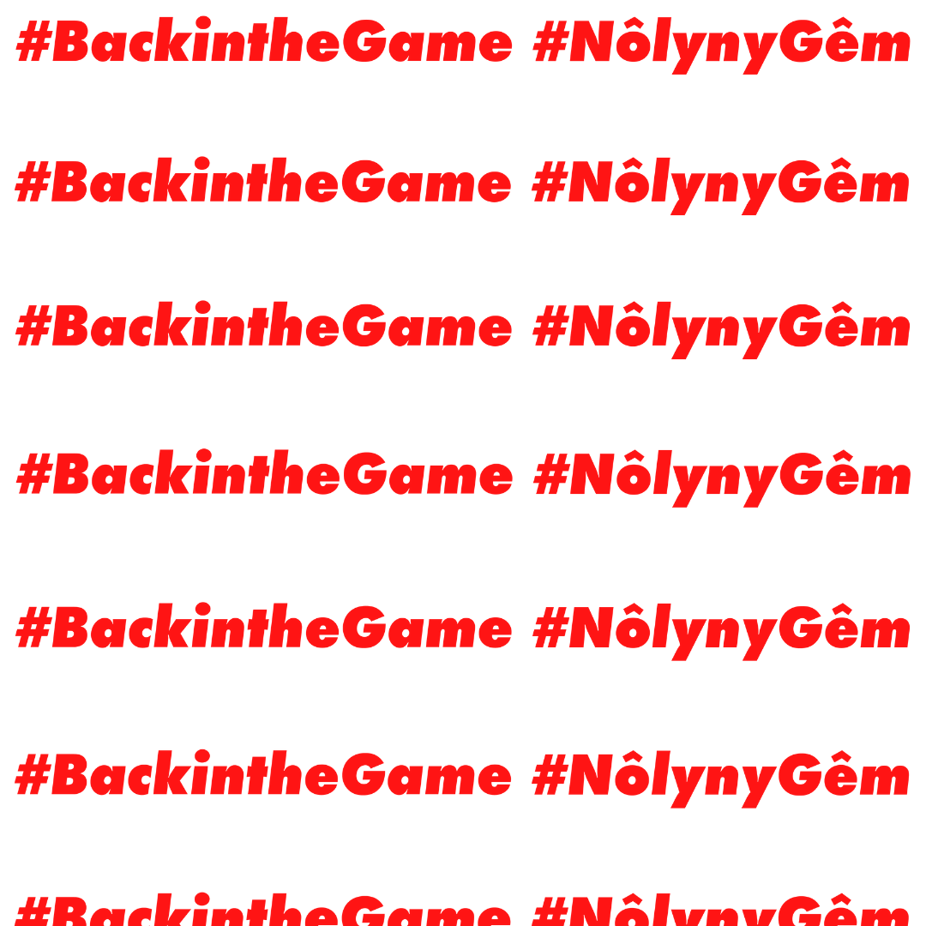
Social media:
Graphics you can use to upload alongside your own images on your social channels (Instagram).

Slide 7
Social media:
Graphic banners you can use on your social media profiles (Facebook).

Slide 8
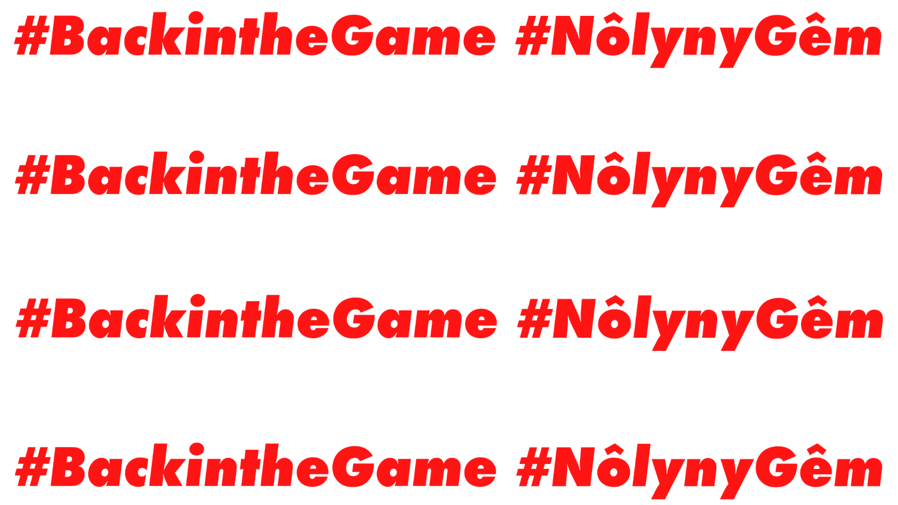
Social media:
Graphic banners you can use on your social media profiles (Facebook).

Slide 9
Social media:
Graphic banners you can use on your social media profiles (Twitter).

Slide 10
Social media:
Graphic banners you can use on your social media profiles (Twitter).

Slide 11
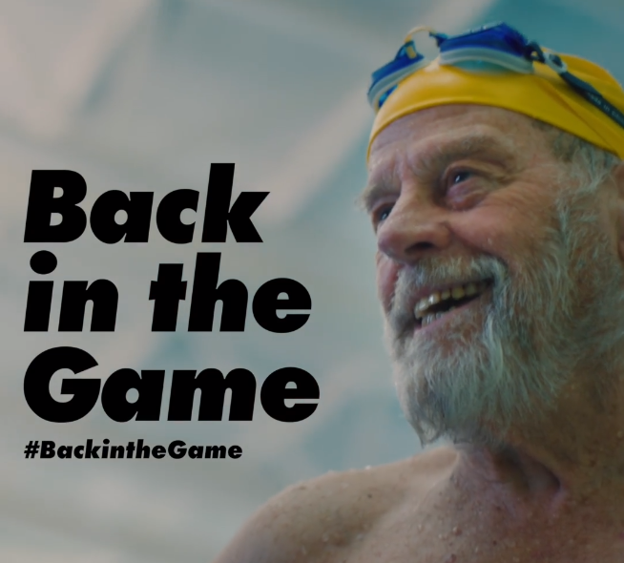
Campaign film
The ‘Back in the Game’ campaign film shows off the excitement of returning to the sport we love and the exhilarating feeling that comes with it.
From football to netball, boxing to swimming, getting back in the game is all about getting back to that joyful feeling of reconnecting with a sport and the community around it.
Download the film here.

Slide 12
Four tips for posting on social media
Tagging:
We recommend tagging @sportwales in any #BackintheGame content. That way we’ll be sure to see your content.
Hashtags:
In any campaign related posts you share on your social accounts, be sure to use the hashtag #BackintheGame and your own specific hashtag/s if relevant.
Emojis:
Emojis can make social media posts more visually engaging, so we’d recommend using 1 or 2 in each post. We’ve included some emojis in the proposed social media posts that you can personalise for your team/club/organisation.
Sharing:
Be active in sharing content related to getting #BackintheGame to share the excitement and exhilarating feeling of returning back to sport! Feel free to retweet, share, like and comment on @sportwales’ content to keep your followers updated on the wider Welsh sport community.

Slide 13
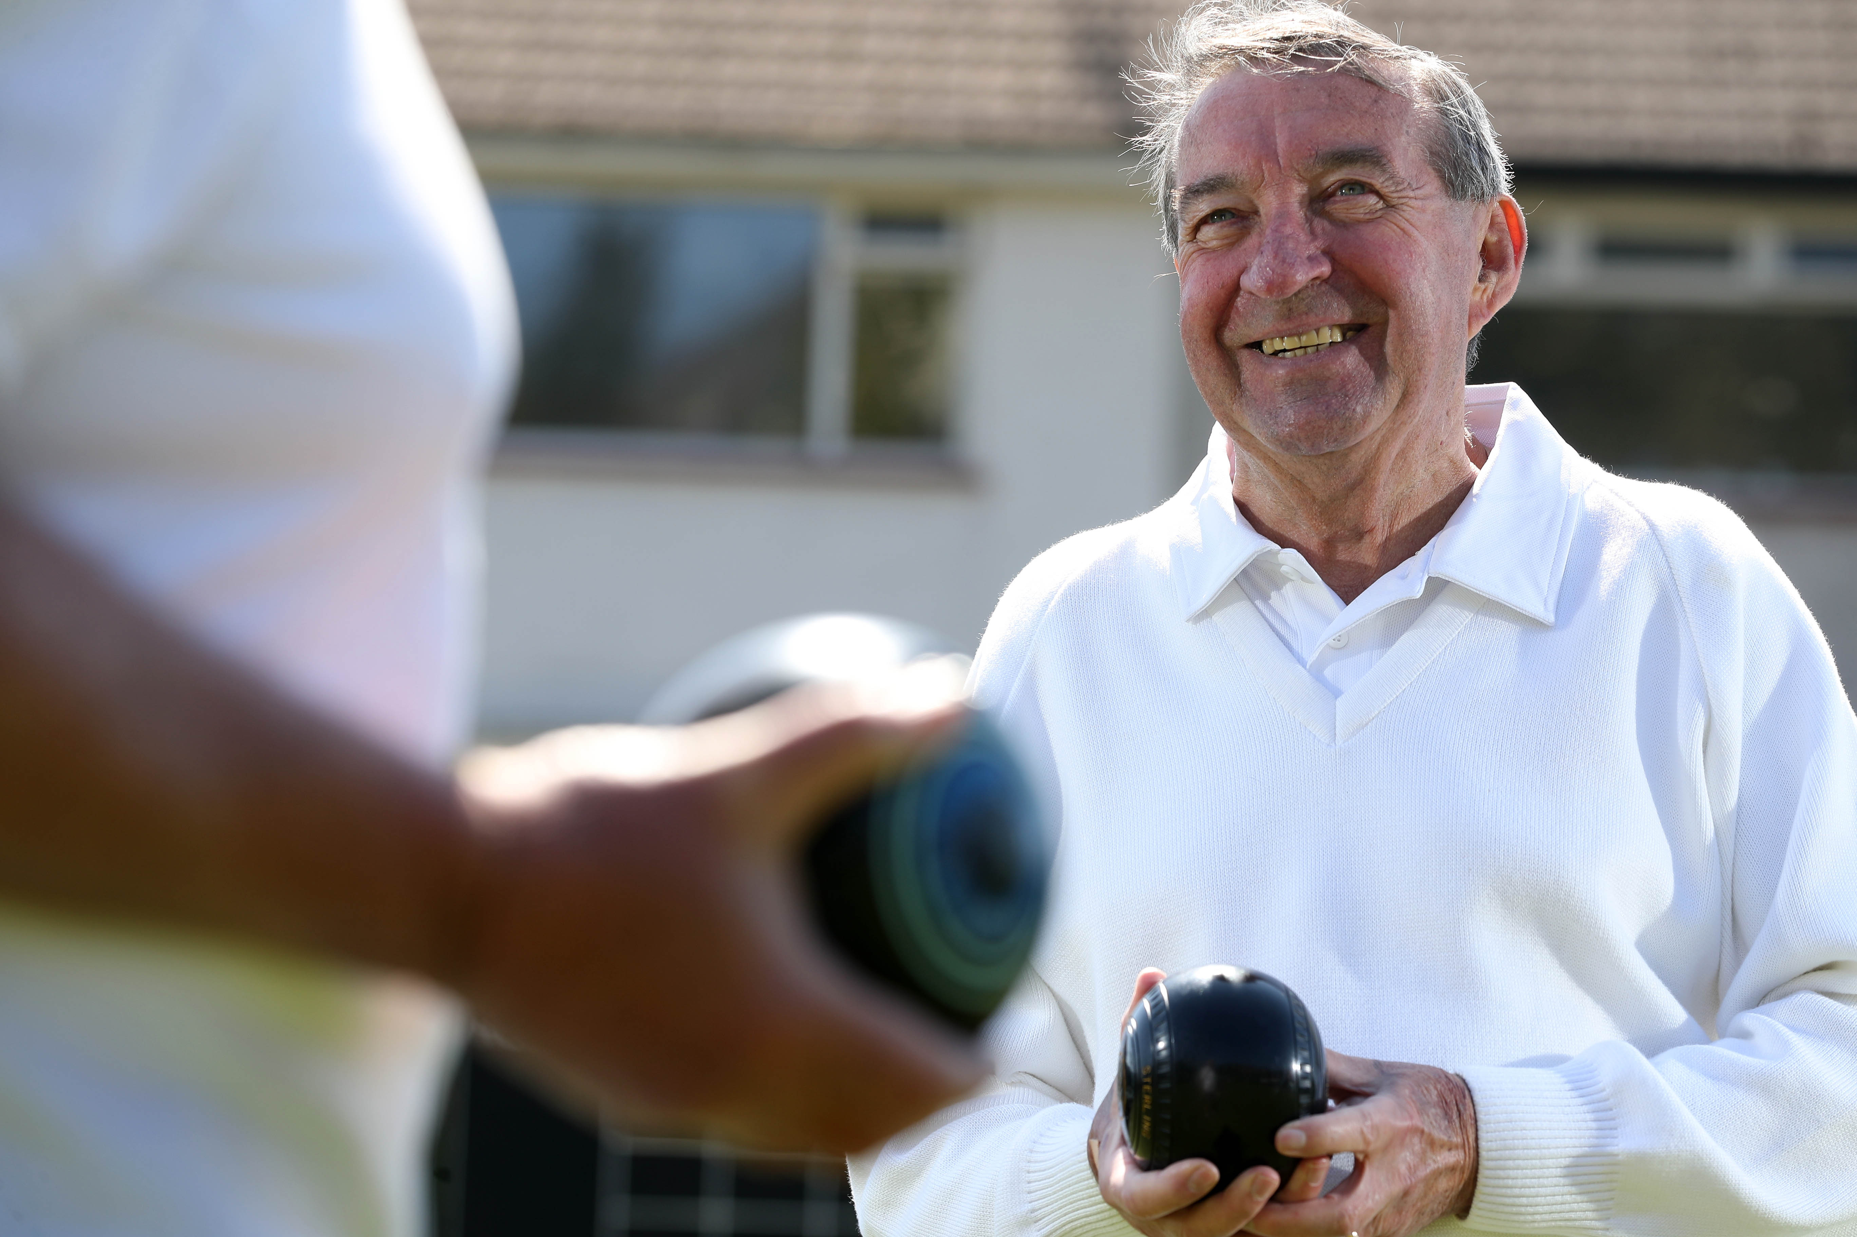
We’d love to hear special, personal stories about how you’re getting back to sport. Get in touch at BackInTheGame@workingword.co.uk
Stories could be worked up for media, film, social or the campaign website.
Motivate: Would the story spur others on to get back in the game?
Confidence: Are their elements which could give others the reassurance they might need to return to action post-lockdown?
Emotion: Is it a story that pulls on the heartstrings?
Unique: What sets out this person’s return to sport apart from their teammates’ journey?

Slide 14
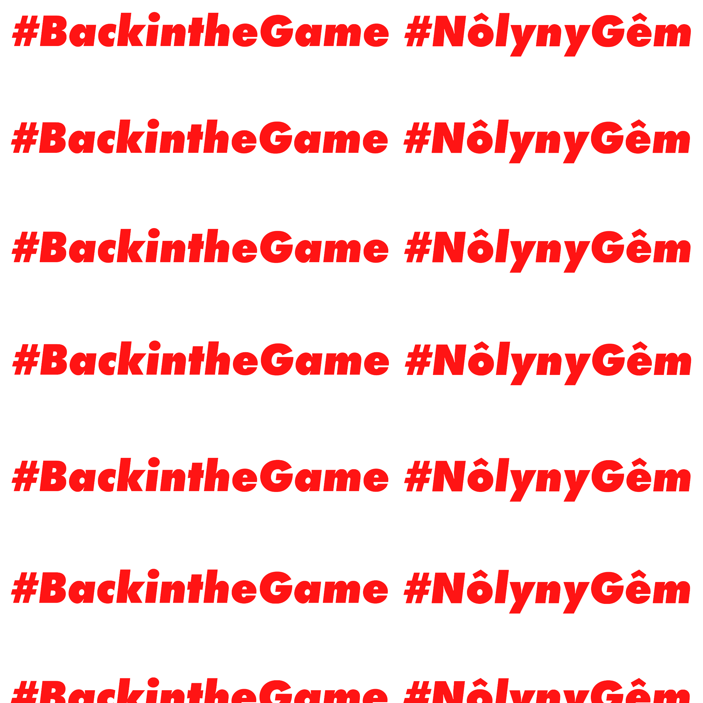
Find us at:
@sportwales on Facebook & Twitter
@sport_wales on Instagram
Or visit www.sport.wales

